Slide 1
GUESTBOOK -App
1600373 / http://1600373.azurewebsites.net/index.php

Slide 2
Features
Logging in The user can log in using their login credentials.
Browsing comments Any user can see and browse all existing comments.
Creating a new comment Users with accounts can create new comment
Editing an existing comment Users can edit existing comments created by them.
Remove old comment Users can remove old comments made by them.

Slide 3
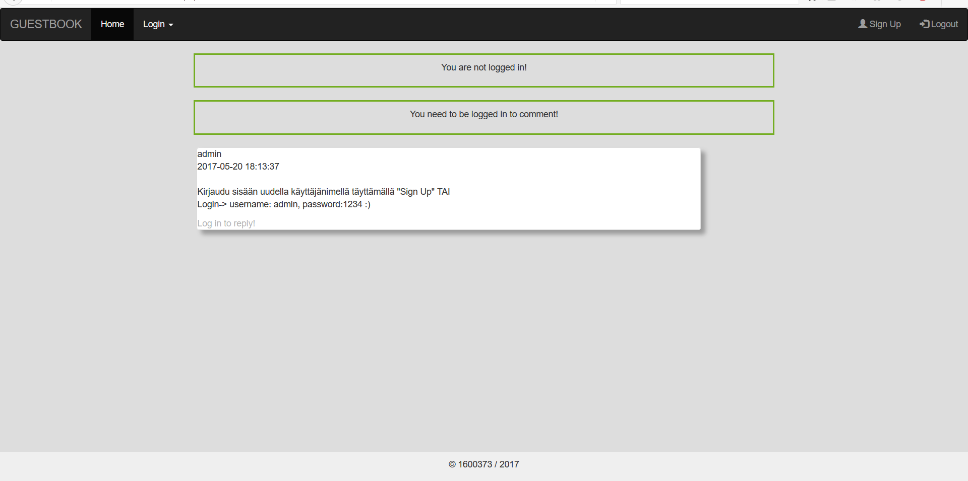
Index
The user is greeted with a very simple frontpage:
Navigation with login feature and a ”Sign Up” –button
If the user is not logged in, it is informed that in order to use the app, one needs to log in.

Slide 4
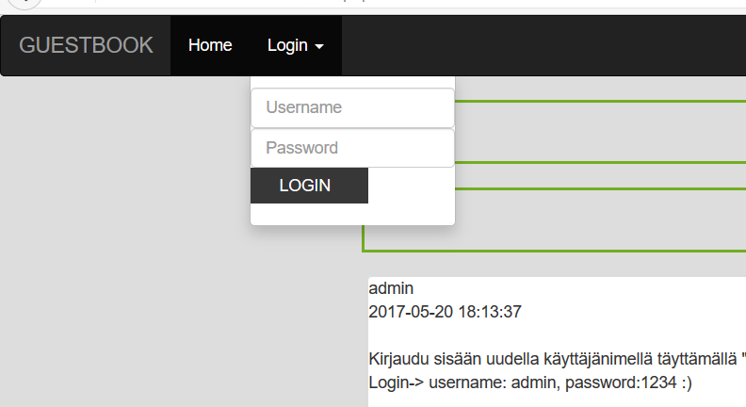
Login
Login only has two forms to fill: username and password

Slide 5
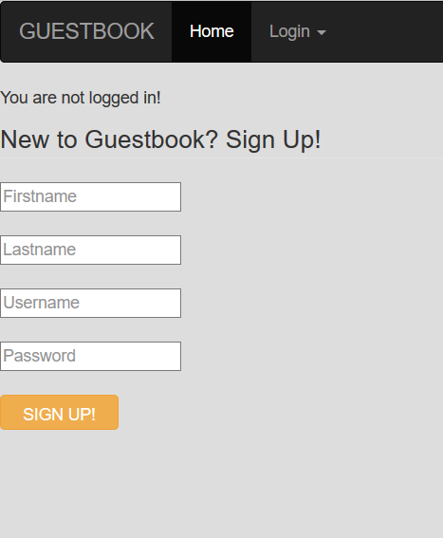
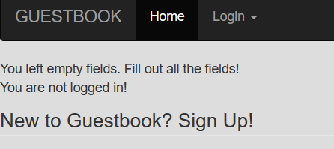
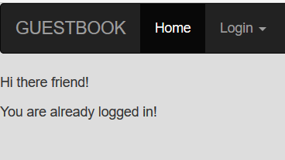
Signing Up
From the ”Sign Up” –button the user is asked to fill in the info.
If the user does not fill all the information s/he is informed that all the information needs to be filled.
If the user is already logged in s/he is also informed of that as well.

Slide 6
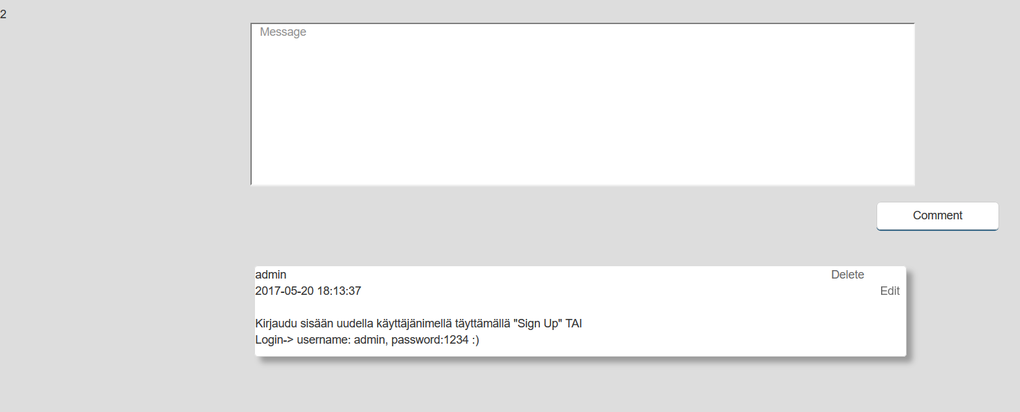
Commenting
Once the user is logged in s/he can comment with a message. The date and time and username is automatically part of the submitted message.
The same user can delete or edit own messages. No one else can do that, so those options are only available once the user is logged in.

Slide 7
Problems with the app
The responsiveness is not persistent
There is a lot of bootstrap that scales the elements nicely to smaller screens as well, but not everywhere.
This is due to the fact that this app has been started over several times (hence the odd filenames as well).
Some minor UI problems:
User is not informed if s/he has succesfully signed up. Only logging in will tell you.
Cookie implementation
If the user closes the browser, it´s the same basically as logging out.

Slide 8
Future development
Fixing the problems and adding more features
Responsiveness
Proper commentsection/forum with different topics
Profile pages
Profile images etc.
Voting for top comments

